Slide 1
Effective Patterns
with C++11 and Boost

Slide 2
me
no books
no blogs
no tweets
no open source

Slide 3


me
Dräger Lübeck
C++ developer
Subsystemdesigner
Trainings/Workshops
Notes:
I am a Feature/Application developer
Not implementing libraries but using them

Slide 4
Motivation
Notes:
Medical domain conservative programmers
Encourage collegues to use boost
By using patterns as an example

Slide 5
My Approach
Notes:
When solving a problem I am considering patterns
Use default version when implementing a pattern
Later strip things off
C++11 my default version look different
That is what I´m going to compare

Slide 6
Unfair
Notes:
Of course this is unfair
My default approach might/will be subobtimal
You have to start somewhere
I hope that it does not matter concerning the conclusion of this talk

Slide 7
Content
Implementation classic vs. C++11
Implementation classic vs. Boost
Application classic vs. C++11/Boost
Conclusion concerning patterns
Notes:
From technical to philosphical

Slide 8
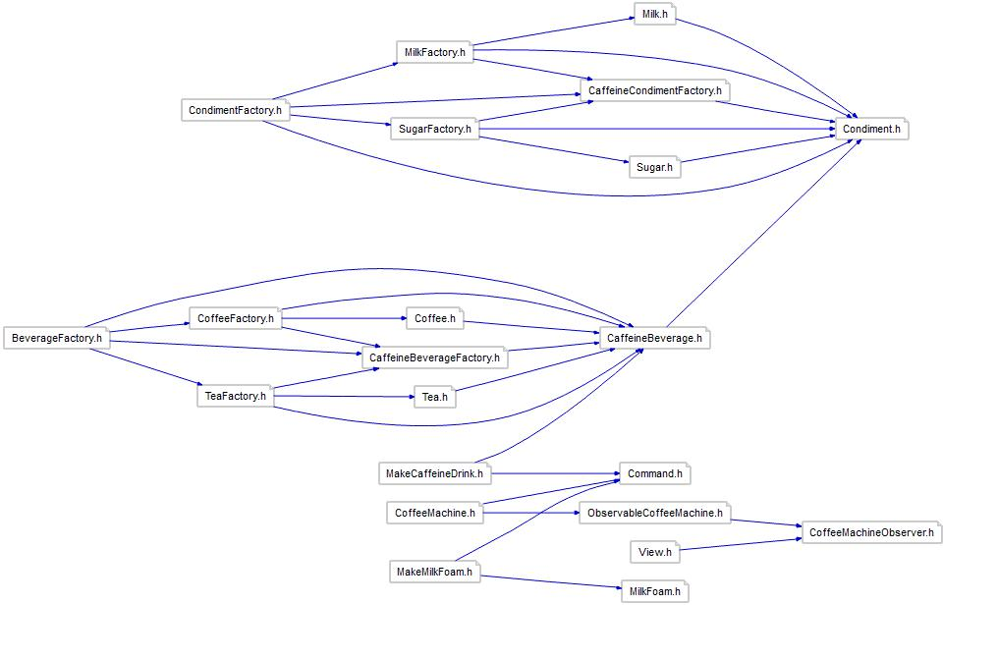
CoffeeMachine (classic) Application

Slide 9
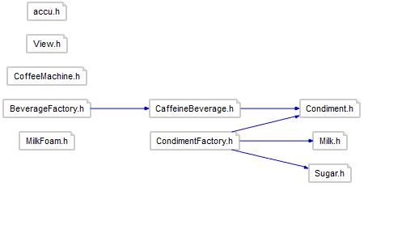
CoffeeMachine (C++11/Boost) Application

Slide 10
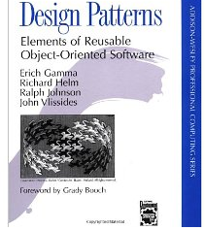

GoF-Patterns
Common solution to a reocurring problem
GoF-Patterns = Micropatterns
How many?

Slide 11
GoF-Patterns
Creational
Abstract Factory
Builder
Factory Method
Prototype
(Singleton)
Structural
Adapter
Bridge
Composite
Decorator
Facade
Flyweight
Proxy
Bahvioural
Chain
Command
Interpreter
Iterator
Mediator
Memento
Observer
State
Strategy
Template
Visitor

Slide 12
GoF-Patterns
Creational
Abstract Factory
Structural
Flyweight
Behavioural
Chain
Command
Observer
Strategy
State

Slide 13
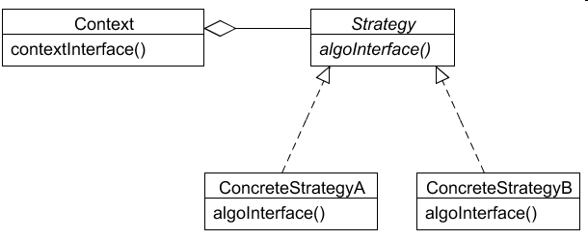
Strategy
Capsules a family of algorithms and makes them exchangeable
Notes:
My favorite pattern
Good for introduction into the oo world
Easy to implement

Slide 14
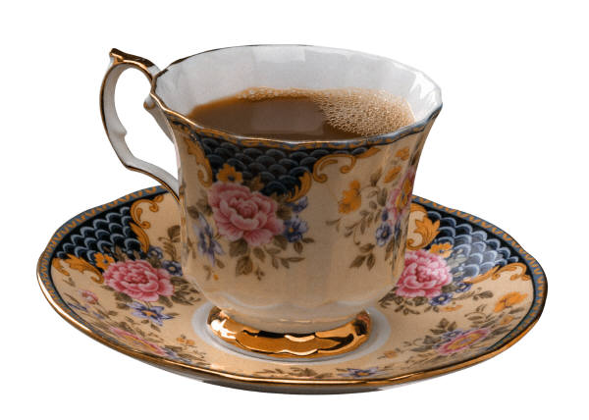

Strategy Example: CaffeineBeverage
1
2
3

Slide 15
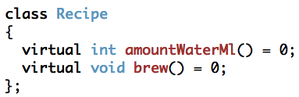
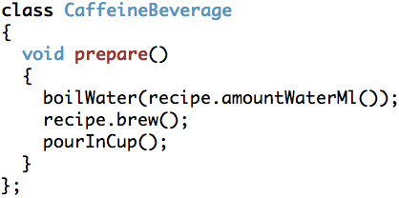
Strategy (classic) Recipe Interface

Slide 16
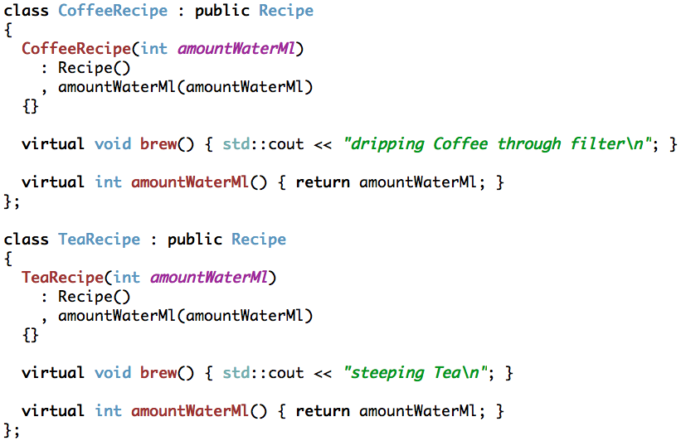
Strategy (classic) Concrete Recipes

Slide 17
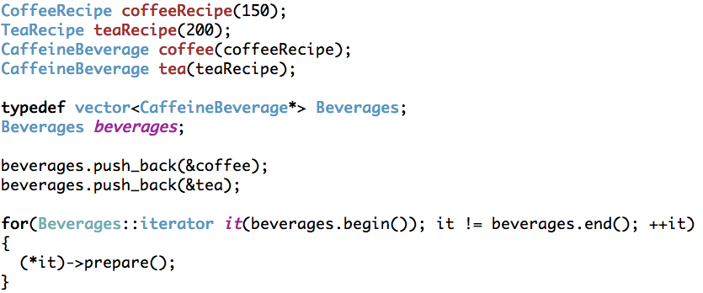
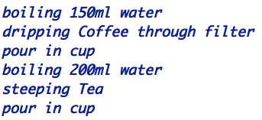
Strategy (classic) Application

Slide 18
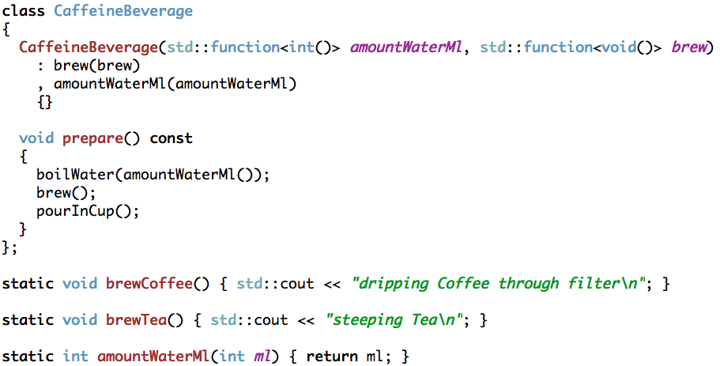
Strategy (C++11) CaffeineBeverage/Recipes

Slide 19
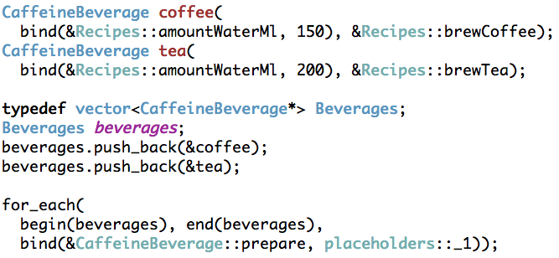
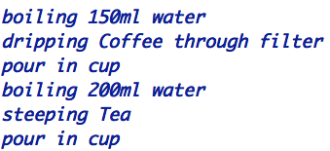
Strategy (C++11) Application with bind

Slide 20
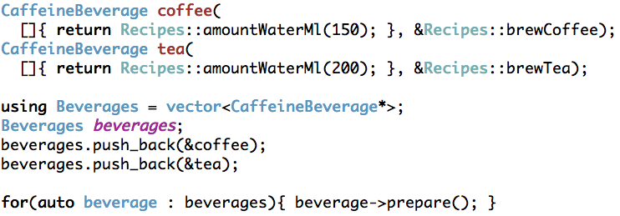
Strategy (C++11) Application with lambda
Notes:
I will show two cpp11 solutions
Bind and lambdas
If lambdas not available -> boost::bind

Slide 21
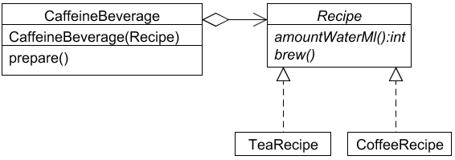
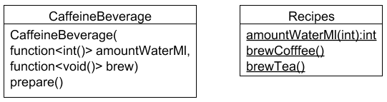
Strategy classic vs. C++11
Classic
C++11
Notes:
Where is the pattern?

Slide 22
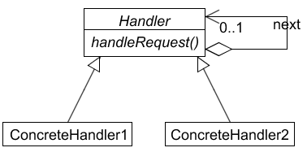
Chain
Avoid coupling the sender of a request to its receiver by giving more than one object a chance to handle the request

Slide 23
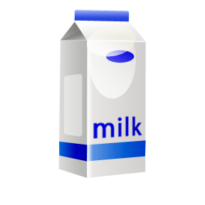
Chain Example: Condiments

Slide 24
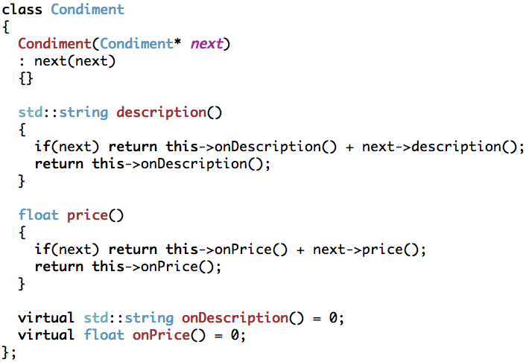
Chain (classic) Condiment

Slide 25
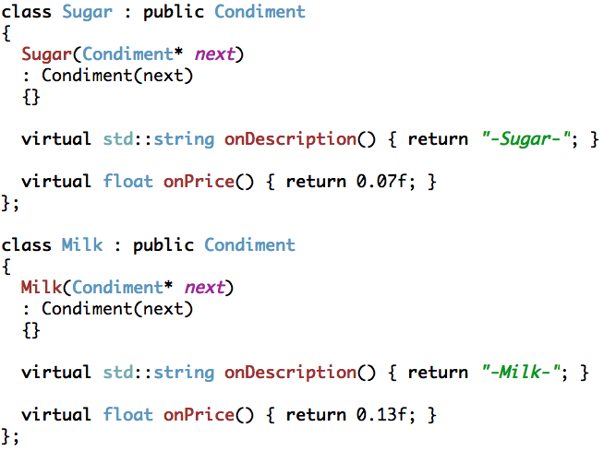
Chain (classic) Sugar and Milk

Slide 26
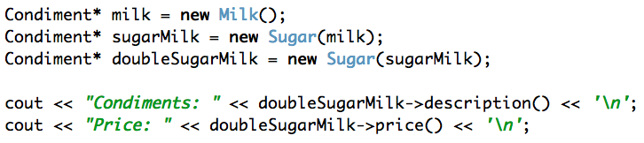
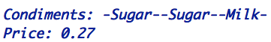
Chain (classic) Application

Slide 27
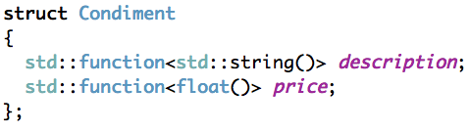
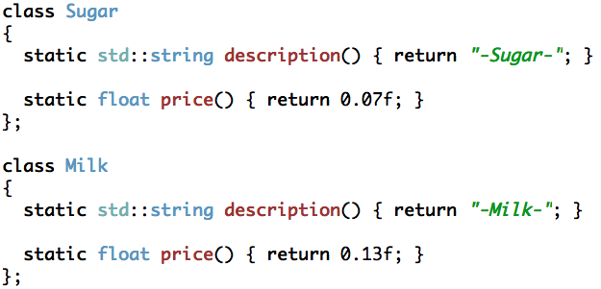
Chain (C++11) Condiment - Sugar and Milk

Slide 28
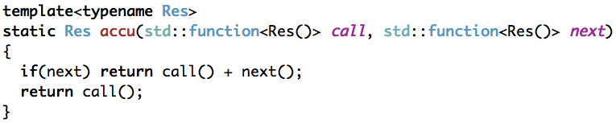
Chain (C++11) accu with function

Slide 29
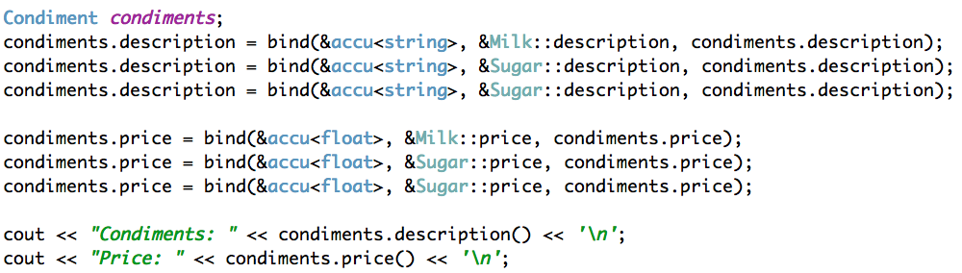
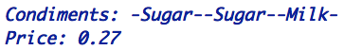
Chain (C++11) Application with bind

Slide 30
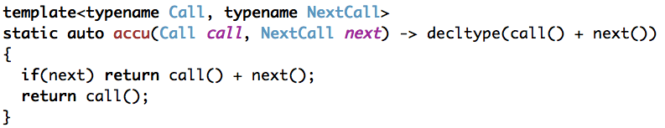
Chain (C++11) accu for lambdas

Slide 31
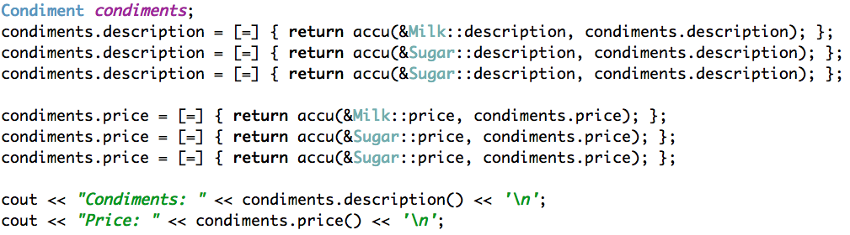
Chain (C++11) Application with lambda

Slide 32
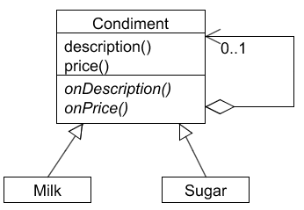
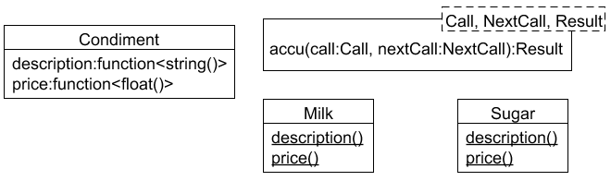
Chain classic vs. C++11
classic
C++11

Slide 33
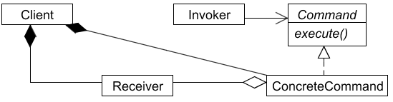
Command
Encapsulate a request as an object

Slide 34
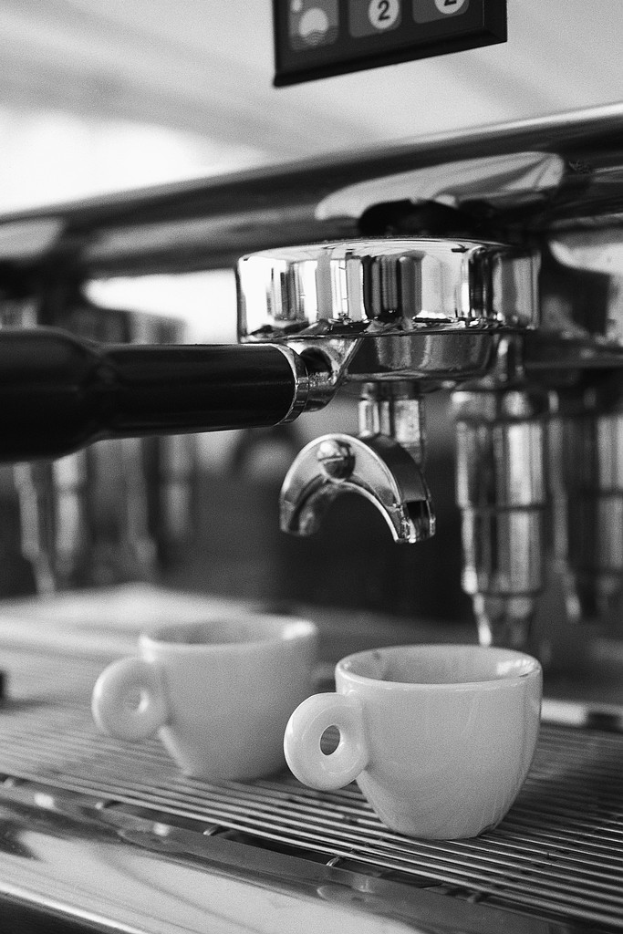
Command Example: CoffeeMachine
Orders:
Coffee
Coffee
Tea

Slide 35
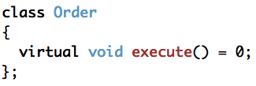
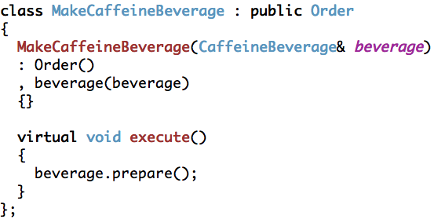
Command (classic) MakeCaffeineBeverage

Slide 36
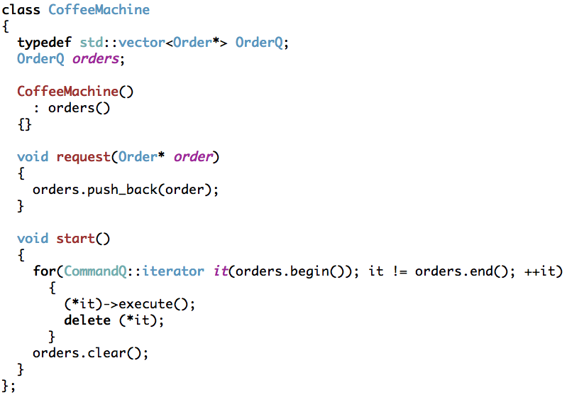
Command (classic) CoffeeMachine

Slide 37
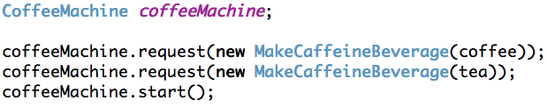

Command (classic) Application

Slide 38
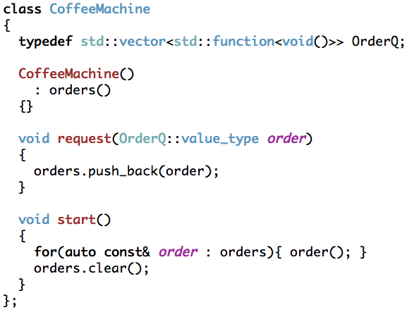
Command (C++11) CoffeeMachine

Slide 39
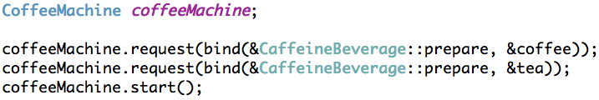
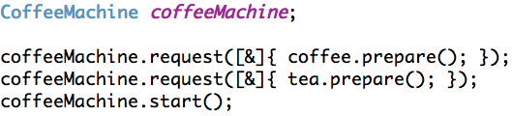
Command (C++11) Application

Slide 40
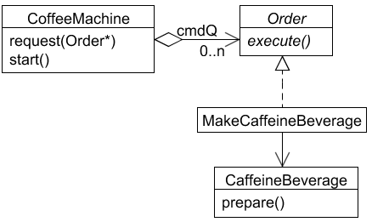
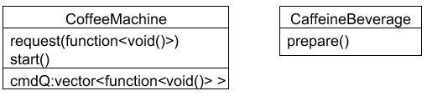
Command classic vs. C++11
classic
C++11
Notes:
Where is the pattern?

Slide 41
Benefits
Notes:
Loose Coupling – Depending on Abstraction not on Implementations

Slide 42
Benefits are maintained
Loose coupling
Extendable
Unit testable
Notes:
Loose Coupling – Depending on Abstraction not on Implementations

Slide 43
Some More Benefits
Less code
Less coupling
Easier to extend
Notes:
Less code to write
No inheritance
No need to write little wrappers just because the name or the signature does not fit

Slide 44
Criticism

Slide 45
Criticism Debugging
Do not debug Library code
Notes:
Do not debug library code

Slide 46
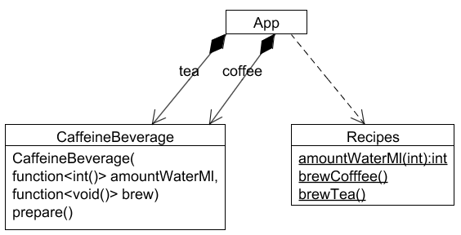
Criticism Too Loose

Slide 47
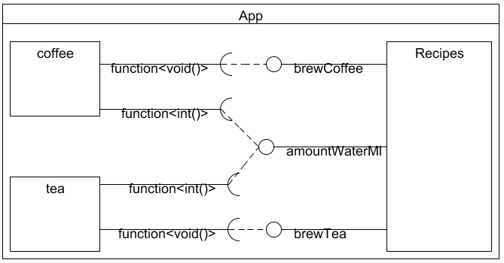
Criticism Too Loose

Slide 48
Criticism Performance
http://probablydance.com/2013/01/13/a-faster-implementation-of-stdfunction/
Compiler | Virtual [ms] | Function [ms] | MalteSkarupke[ms]
VS 2012 Debug | 1917 | 4195 | 3262
VS 2012 Release | 800 | 770 | 630
Clang 3.1 –O0 –g3 | 1864 | 3161 | 2513
Clang 3.1 –O3 | 564 | 474 | 456
GCC 4.7.2 –O0 –g3 | 1755 | 3363 | 2587
GCC 4.7.2 –O3 | 555 | 466 | 431

Slide 49
Criticism Size
http://dl.dropbox.com/u/27990997/compare_functions.cpp
Compiler | Virtual [bytes] | Function [bytes]
Clang 3.3 –O0 –g3 | 58608 | 110808
Clang 3.3 –O3 | 24044 | 35096

Slide 50
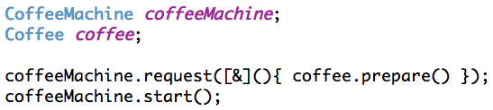
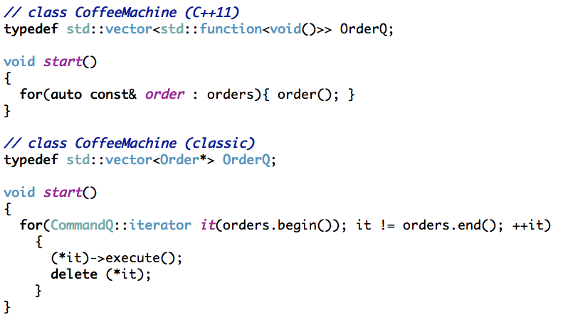
Criticism Ownership

Slide 51
Criticism Ownership
Notes:
No reuse of commands possible
By the way, count of deletes in GoF book?

Slide 52
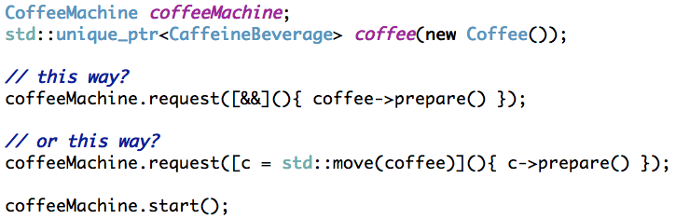
Criticism Transfer of Ownership
http://isocpp.org/files/papers/n3610.html
Notes:
Currently not possible

Slide 53
Patterns and Boost

Slide 54
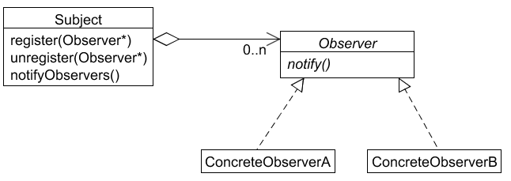
Observer
Define a one-to-many dependency between objects so that when one object changes state, all its dependents are notified and updated automatically.

Slide 55


Observer (classic) Example: Finished!

Slide 56
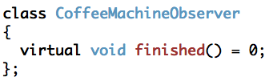
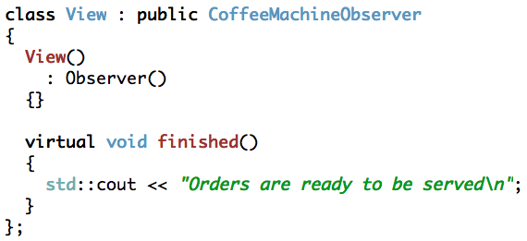
Observer (classic) CoffeeMachineObserver

Slide 57

Observer (classic) CoffeeMachine

Slide 58


Observer (classic) Application

Slide 59
Observer Boost.Signals2
Managed signals/slots system
Controlling order of callbacks
Connection tracking

Slide 60

Signals Introduction Slots

Slide 61

Signals Introduction Connect

Slide 62

Signals Introduction Order

Slide 63


Signals Introduction Tracking
Notes:
Track_foreign for std::..ptr
Track for boost::...ptr
Slot_type does the binding

Slide 64
More about Boost.Signals2
Explicit connection management
Combining multiple return values
Thread-Safe
Header-Only
Notes:
Connect/disconnect – block/unblock
Default is boost::optional<T> because signal can be triggered without any function attached to it

Slide 65


Observer (Signals) CoffeeMachine
Notes:
Thread-safe is default
Dummy mutex disables thread-safety

Slide 66


Observer (Signals) Application

Slide 67


Observer classic vs. Signals
classic
Boost
Notes:
Where is the pattern?

Slide 68

Factory
Provide an interface for creating families of related or dependent objects without specifying their concrete classes

Slide 69
Factory (classic) Example: BeverageFactory

Slide 70

Factory (classic) CaffeineBeverageFactory

Slide 71

Factory (classic) BeverageFactory

Slide 72


Factory (classic) Application

Slide 73
Factory Boost.Functional.Factory
Lets you encapsulate a new expression as a function object

Slide 74

Introduction Functional.Factory

Slide 75
Introduction Functional.Factory
Forwarding arguments to the constructor
Member functions to create different kinds of objects
Factory base class might not be necessary
Allows use of customized memory management

Slide 76

Factory (Boost) BeverageFactory
Notes:
Returns unique_ptr

Slide 77

Factory (Lambda) BeverageFactory
Notes:
No need for boost.factory with lambdas

Slide 78

Factory (Boost/Lambda) Application
Notes:
No need to delete beverages because of unique_ptr

Slide 79


Factory classic vs. Boost.Functional.Factory
Classic
Boost

Slide 80
Library Benefits
Has been done for you
Just using the library
Many shortcomings addressed

Slide 81
Library Benefits
Development speed up
GoF-Patterns focused on OO-paradigm
Use of generic prgramming model

Slide 82
Boost and Patterns
 | Function Bind | Phoenix Lambda | Signals | Statechart MSM | Flyweight
Chain
Command
Observer
Strategy
State
Proxy
Prototype

Slide 83

Boost and Patterns Flyweight

Slide 84

Boost.Flyweight Example: Colour

Slide 85

Boost.Flyweight Boost.Hash

Slide 86

Boost.Flyweight Boost.Hash

Slide 87
Boost.Flyweight
Tagging
Hash- or Set-based Tablelookup
Trackingpolicy for Values
Lockingpolicy for Factory

Slide 88

Boost.MSM State
EDSL for transitiontable
State, Transition, Event
Submachines, Orthogonal Regions, Pseudostates
History
Completion/Anonymous transition
Internal transitions (Action in State)

Slide 89

MSM Example: Ping - Pong

Slide 90

MSM States

Slide 91

MSM Actions

Slide 92

MSM Transitiontable

Slide 93


MSM Application

Slide 94
Putting it all together
Writing a Coffeemachine application
Putting all the patterns together

Slide 95

Putting it all together classic

Slide 96

Putting it all together classic

Slide 97

Putting it all together classic

Slide 98

Putting it all together C++11

Slide 99

Putting it all together C++11

Slide 100

Putting it all together C++11

Slide 101
Putting it all together (classic) Dependencies

Slide 102
Putting it all together (C++11/Boost) Dependencies

Slide 103
Putting it all together Analysis
 | classic | C++11
CountDeclClass | 25 | 12
CountDeclMethodAll | 168 | 58
CountLineCode | 522 | 278
CountPath | 74 | 31
MaxInheritanceTree | 1 | 0
SumCyclomatic | 74 | 31

Slide 104
Conclusion 3 Observations
Notes:
Make all your interfaces structs with functions as members!
C++11 added some feature like function and lambdas and all of a sudden some patterns are no longer visible
What does that tell us about patterns?
Well it is obvious!

Slide 105
Patterns are crutches ...
... for features that the language does not have
Notes:
Crutches for features that the language does not have
Functional style in an OO-Language
With function, bind, lambdas patterns become implicit
Patterns like class, disposable not known in C++

Slide 106
Peter Norvig
16 of the 23 GoF patterns are simpler or even invisible in higher-level languages
http://norvig.com/design-patterns/ppframe.htm

Slide 107
Where is the Pattern? Strategy

Slide 108
Where is the Pattern? Chain

Slide 109

Where is the Pattern? Command

Slide 110
Jeff Atwood
Design patterns are a form of complexity
http://www.codinghorror.com/blog/2007/07/rethinking-design-patterns.html

Slide 111
Patterns for Communication
Notes:
Don´t care if patterns are now invisible
They have to be explicit
So I can communicate with others
Some better than others e.g. Visitor big but small, Bridge/Strategy small but big

Slide 112

Patterns for Communication Solving Problems
Strategy
Notes:
Effective way to communicate solutions for a problem
Name of pattern is connected with an approach
Given approaches a name is hughe benefit from Gof-book
One word connected to whole chapter (pretty effective)
That is why Alexander speaks about a pattern language
Our skull is limited in size -> name → approach

Slide 113
Patterns for Communication Solving Problems
Strategy
Notes:
Jeff Attwood – patterns are receipes
Cut-And-Paste solutions

Slide 114
Patterns for Communication Solving Problems
Classic
C++11
Notes:
Why not use function pointer and static functions in classic approach
Boost::function made me realize this

Slide 115
Patterns for Communication Implementation is a detail
Notes:
Implementation of a pattern is a detail
This at best is one solution
Implementation of patterns depends on context
Comunicating this with class diagrams might be a mistake of Gof

Slide 116
Patterns for Communication Flyweight

Slide 117



Patterns for Communication Chain

Slide 118


Patterns for Communication Observer

Slide 119

Patterns for Communication Command

Slide 120
It is not a requirement for a pattern to be visible in a class diagram

Slide 121
2nd Edition – GoF book ?

Slide 122
Evolution
Assembler → if/else, do-while, ...
C → class, polymorphism, ...
C++ → Strategy, Command, ...
C++11 → ...
Notes:
Begining with C++11 std::function first choice for beeing extendable
Library/Languagefeature name replaces pattern name
Teach to use std::function instead of interfaces
Like vector is container of first choice

Slide 123
Pattern Lifecycle
Discovered
Published
Test of time
Adopted by language/library
Disapears

Slide 124
PPG
Pattern
Preservation
Group

Slide 125




Books

Slide 126
Thank you for your attention

